Slide 1
Chatbot for Student Services Office at FILS Faculty
Team members:
Minescu Andrei
Manolescu Alexandru
Cerneanu Valentin
Alshikh Sulaiman Rim

Slide 2

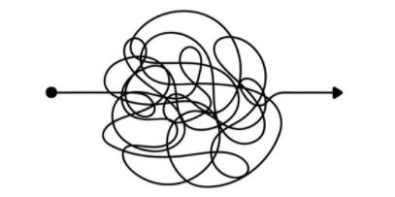

Waiting time
Rules & procedures
UPB Student
Student Office
Paperwork-centric
Lack of communication
Why?
Digitalization of educational institution
=
essential global trend in terms of reformation and modernization

Slide 3


UPB Student
Student Office
Identify:
Main common requested tasks
Daily changes & news
Essential information
How?
& What?
An online available 24/7 system that has the goal to streamline the interactions between students and the Staff from the Student Office

Slide 4
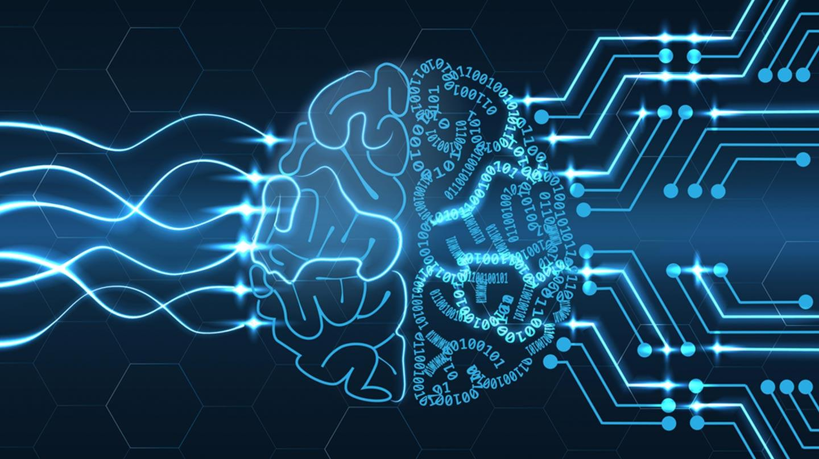

Artificial intelligence (AI) has influenced how we engage in our everyday life
Chatbot
=
AI program and a Human–computer​ Interaction (HCI) model
Used across a wide range of domains, including public administration and education
Productivity
Reduction of service costs and waiting time
Are friendly and attractive to users (e.g., compared to static FAQs list)

Slide 5
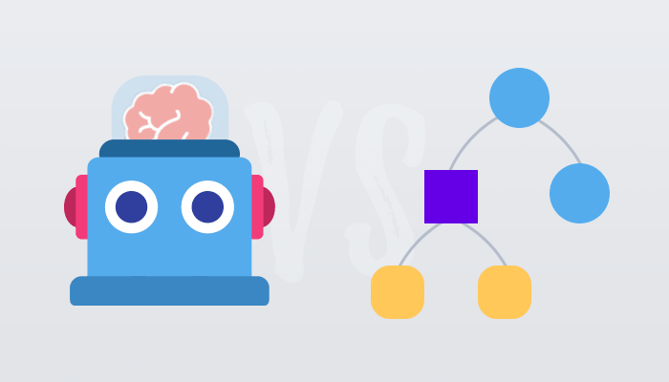
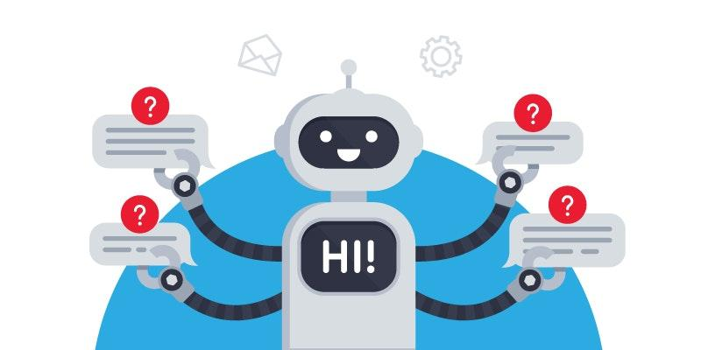
Approaches in developing a chatbot
Rule-based bots
Machine Learning bots
Guided by a decision tree
AIML and Rivescript
Artificial Neural Networks (ANNs)
Multi-turn answer selection

Slide 6
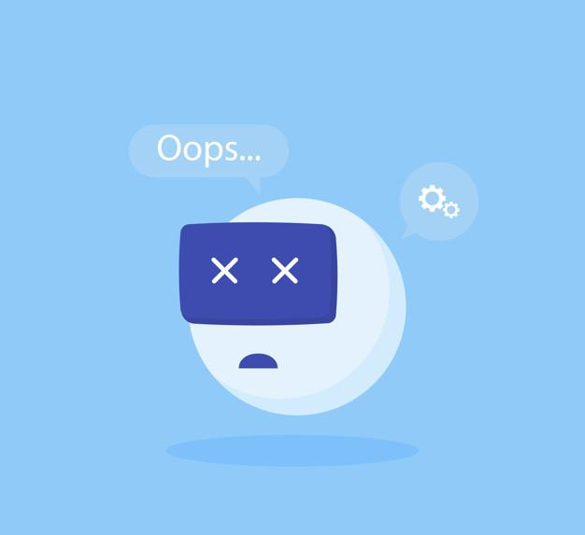
Main drawbacks
Failure in intent understanding
Challenging to create a chatbot from scratch for a legacy system
Require Maintenance and maintaining updated

Slide 7
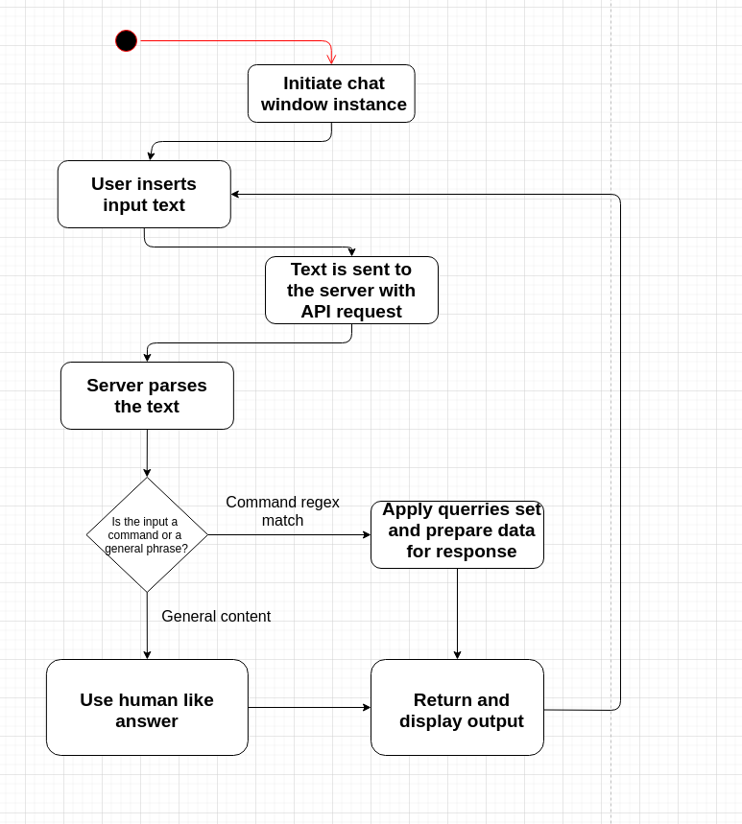
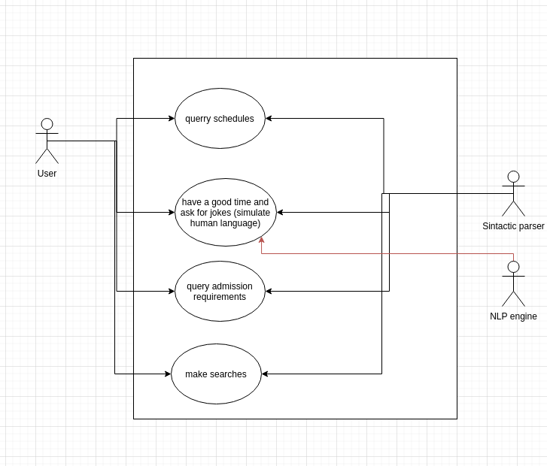
SysML diagrams

Slide 8
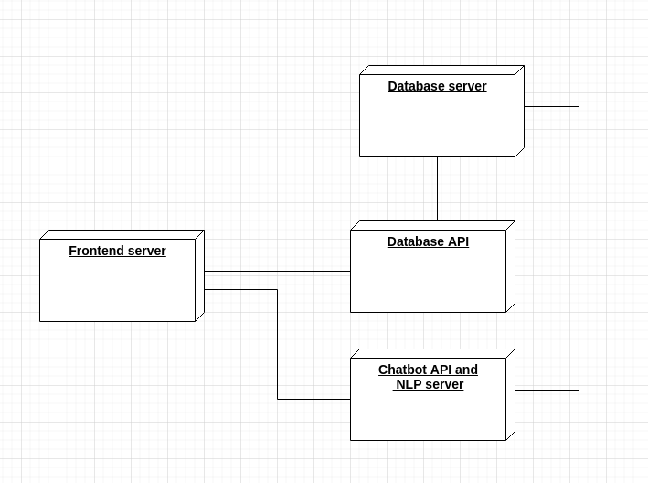
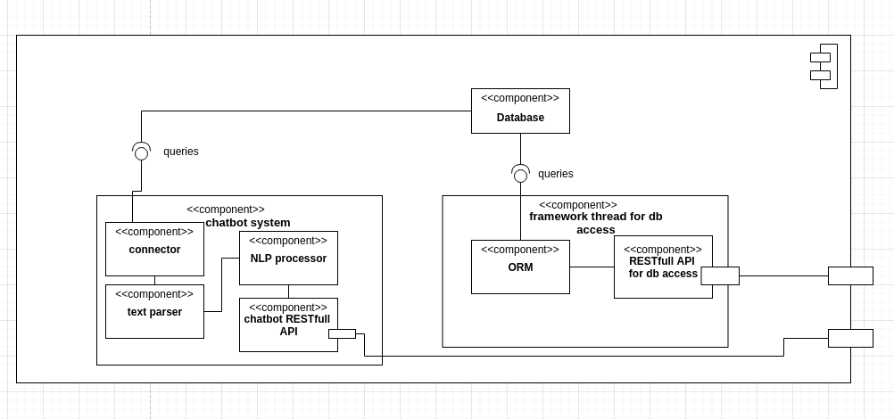
Deployment Diagram
Components Diagram

Slide 9
System requirements
Latency: low because of own infrastructure
Capacity: very scalable storage
Security: JSON Web Token used in the https requests, permission roles assigned
Integrability: Since both the database delegate and the Chatbot use REST API, they can be used both in-house but can also be integrated with other software
Deployment: own infrastructure, scalable both horizontally and vertically
Robustness: servers self restarts after power failure
Backup: NetCloud with own servers
Reusability: very high because of modular components
Documentation
Useability: the software has some sort of gamification. It has good interactivity and self explanatory

Slide 10
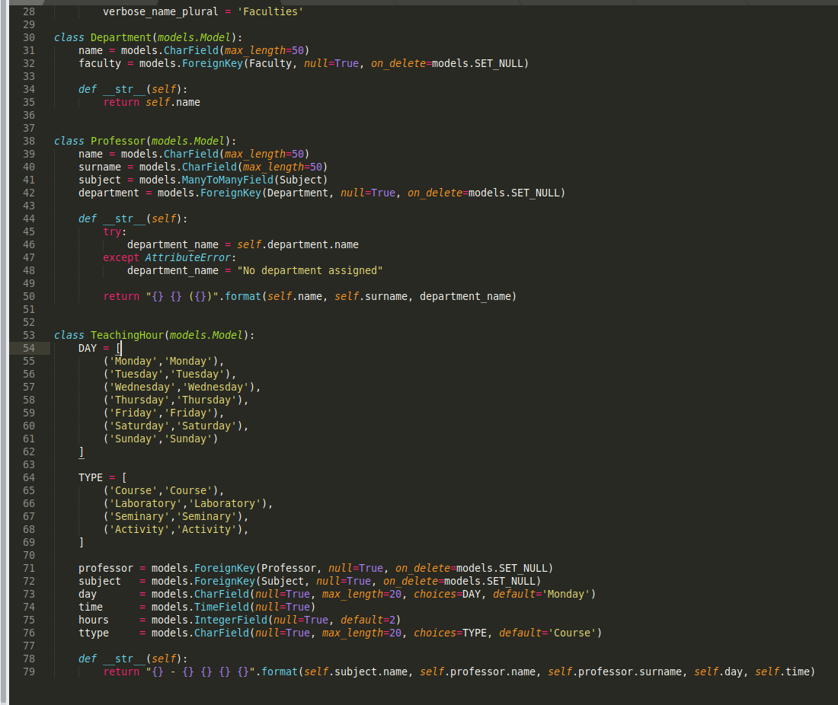
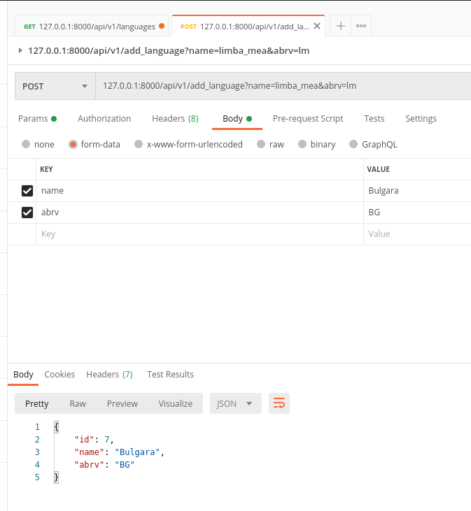

Slide 11
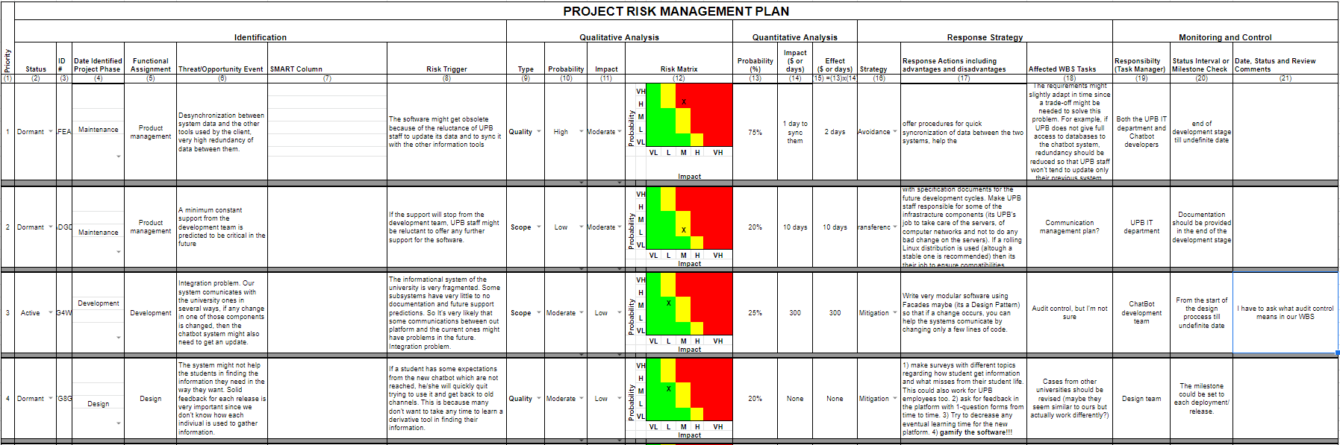
Challenges and issues
CHALLENGES AND ISSUES
One main risk identified in the maintenance stage is that the capabilities of the chatbot can become outdated.

Slide 12
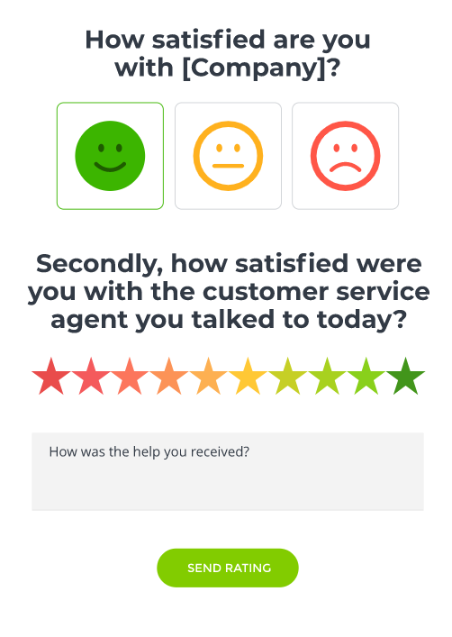
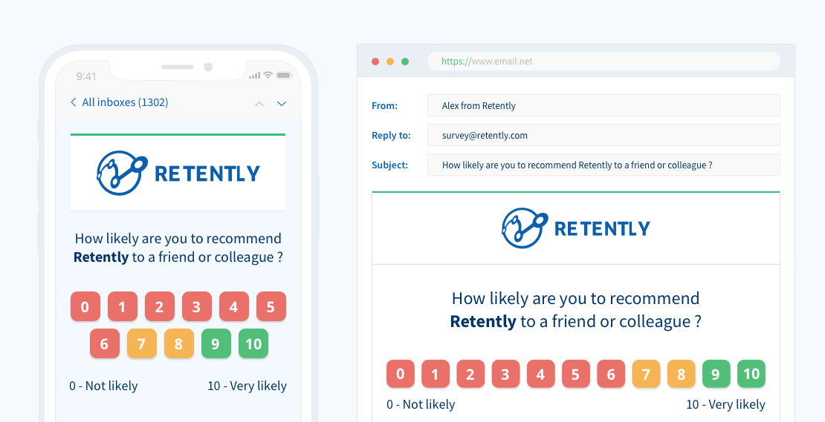
Quality assurance plan
Net Promoter Score (NPS)
2. Customer Satisfaction Score (CSAT)

Slide 13
Stakeholders & their needs
Students:
Waiting time spending
Find in a direct & targeted way the necessary information
Solve easily their requests
Secretary from Student Office:
Reduce the students flow for common information requests
Simple and direct communication for news to students
UPB Leadership (Dean, Vicedeans, Executive Board):
Optimize the administrative procedures
Reduce resources

Slide 14
Implementation demo

Slide 15
Conclusions
Chatbot for Student Services Office at FILS Faculty is a complex system which success is dependent on multiple tasks
The planning part is the key part for having a steady and stable implementation
Two different approaches.
build the whole system from scratch
configuring a web ChatBot and paying a subscription.
There is no doubt that a university should have a web chat bot for the site. A good chat bot can save a lot of time for the university staff but also for the students

Slide 16
Thank you :)

